Slide 1
WELCOME
TO OUR PRESENTATION

Slide 2
Date:10-11-2024
TOPIC: Power Supply Circuits in Consumer Electronics.
SUBMITTED BY:
Sheikh Ataharul Islam Labib
ID: 241-15-828
Department: CSE
Section: 66-O
Umma Kulsum Bithi
ID: 241-15-597
Department: CSE
Section: 66-O
Hasibul Hasan
ID: 241-15-424
Department: CSE
Section: 66-O
Nishat Tasmin
ID: 241-15-648
Department: CSE
Section: 66-O
SUBMITTED TO:
MS.Subarna Akter Liza
Lecturer, Department of CSE.
Daffodil International University.

Slide 3
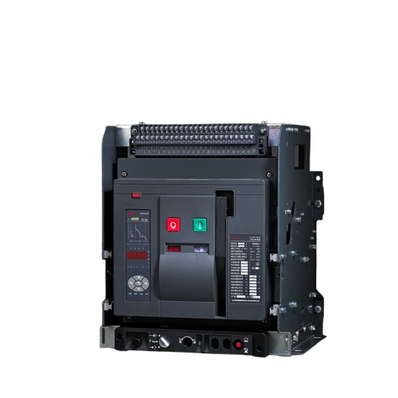
Introduction
Slide No:01
Power supply circuits are essential components in consumer electronics, responsible for converting electrical energy into a form suitable for the operation of devices like televisions, computers, smartphones, and household appliances. These circuits ensure that the right voltage, current, and frequency are delivered to the electronic components.
AC-DC Converters and Adapters
Mobile Phones Charging Circuits
Battery Circuit Protection
Fig:01

Slide 4
Slide No:02
AC-DC Converters and Adapters
Ac -Dc converters and Adapters are essential components in modern electronics. Allowing devices that require direct current( DC) to operate from alternating current ( AC) sources.
Component
AC-DC converters
Filter
Rectifier
AC-DC converters are devices used to convert alternating
current (AC)to Direct current (DC).
Smooths out the DC signal by removing
ripples, usually with capacitors.
Converts Ac to Dc using diodes.

Slide 5
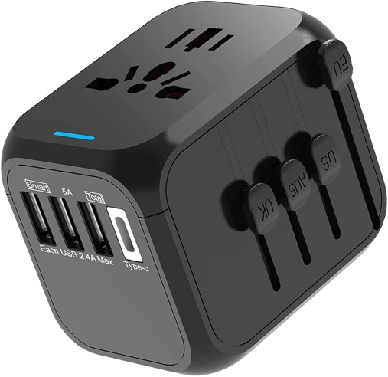
Type
Adapter
Power Bank
Wall Adapters
Slide No:03
Adapters are practical application of AC -DC converters.
Portable solutions that store DC
power for later use in devices.
Plug directly into an AC outlet and often provide a specific voltage and current rating .
Fig:02

Slide 6
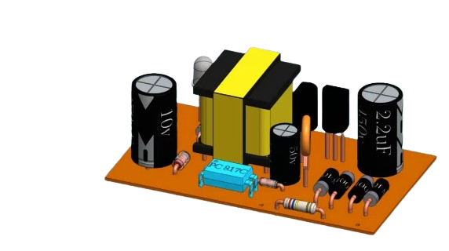
Slide No:04
Mobile Phone Charging Circuits
Mobile phone charging circuits, particularly those for fast charging and wireless charging, have evolved significantly to enhance efficiency and convenience. Here’s an overview of both types:
1.
Fast Charging Circuits
2.
Wireless Charging Circuits
Fig:03

Slide 7
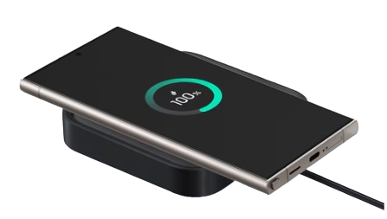
Slide No:05
Fast Charging Circuits:
Fast charging circuits enable higher current and voltage to charge a device more quickly than standard charging methods.
Key Technologies
Communication Protocols
Voltage Regulation
Fig:04
Fast charging protocols involve
raising the voltage.
It requires communication between
charger and device.

Slide 8
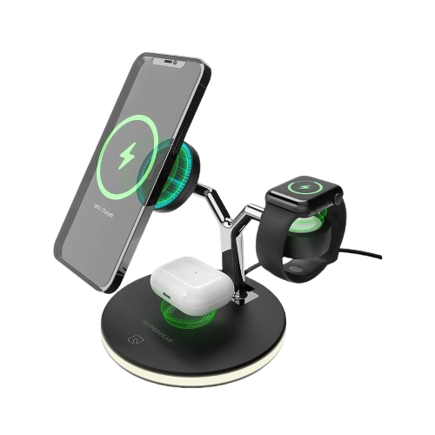
Slide No:06
Wireless Charging Circuits
Wireless charging, or inductive charging, uses electromagnetic fields to transfer energy between a charging pad and the mobile device.
Key Technologies
Inductive Coupling
Resonant Inductive Coupling
Fig:05
This method uses two coils to create a magnetic field.
Similar to inductive coupling but allows for
greater distance between coils.

Slide 9
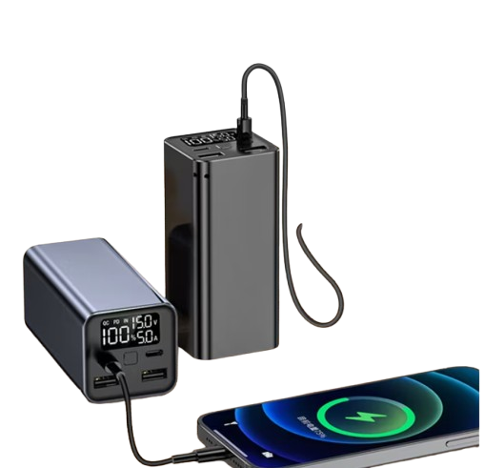
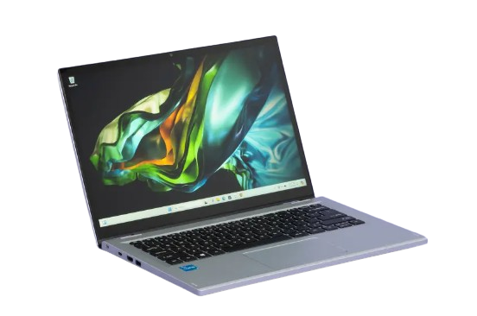
Slide No:07
Battery Circuit Protection
Battery protection in laptops and mobiles uses a Battery Management System (BMS) to prevent overcharging, over-discharging, overheating, and short circuits. The BMS regulates voltage, current, and temperature, while smart charging features limit charge levels to protect battery health, extend lifespan, and ensure safe, reliable performance in both devices.
Fig:06

Slide 10

Slide No:08
Conclusion
In consumer electronics, power supply circuits play a critical role in delivering safe, efficient energy. AC-DC converters, advanced mobile charging circuits, and robust battery protections enhance device performance and safety. These technologies ensure optimal charging, protect battery health, and support user convenience, driving reliability in everyday electronic devices.
Fig:07

Slide 11
THANKS!

